Slide 1
Review of Screening and Treatment of Unhealthy Alcohol Use in People Living with HIV Srinivas Muvvala, MD MPH

Slide 2
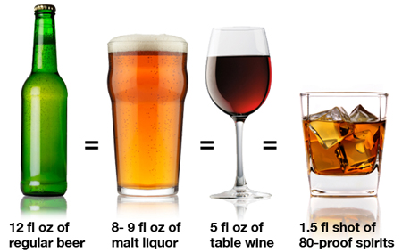
What defines at-risk alcohol use?
 | Drinks/ day | Drinks/ week
Men | > 4 | > 14
Women | > 3 | > 7
All Age >65 | > 3 | > 7
1 drink =

Slide 3
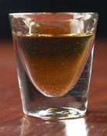
What is a standard drink?
14 grams of alcohol
12 ounces of beer (350ml)
5 ounces of wine (150 ml)
1.5 ounces of distilled spirits (45 ml)
Notes:
What is a drink?
A drink is defined as 14 grams of alcohol which can be found in 12 oz of beer, 5 oz of wine or 1.5 oz (one shot) of distilled spirits.

Slide 4
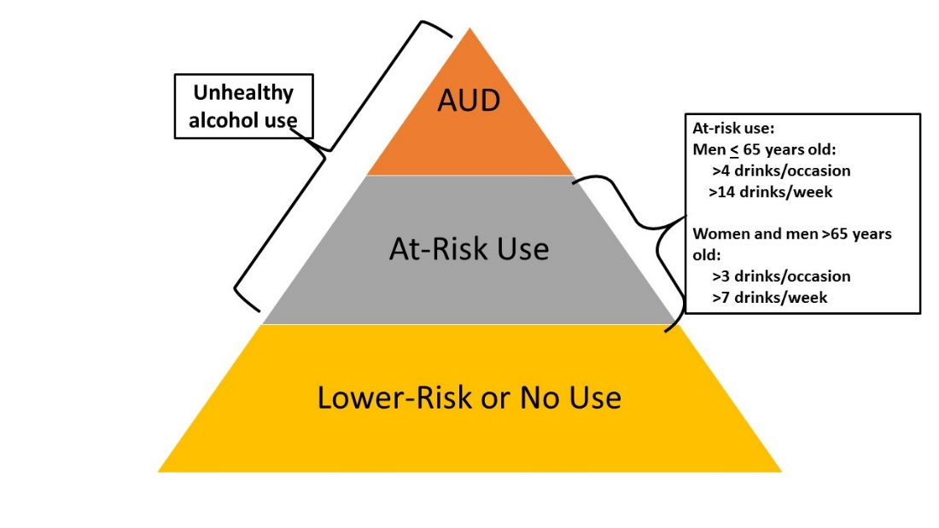
Spectrum of Alcohol Use

Slide 5
Prevalence and Impact of Alcohol Use among People living with HIV (PLWH)
Among PLWH receiving medical care:
54% report recent alcohol use (CDC 2016)
27% screened positive for unhealthy alcohol use (Crane AIDS Behav 2017)
Alcohol negatively impacts HIV disease control, medical and psychiatric comorbidities
Dose response effects on antiretroviral medication adherence
Cardiovascular disease, liver disease, malignancies, cognitive dysfunction
Depressive symptoms
Sexual risk behaviors and HIV transmission

Slide 6
Screening for Unhealthy Alcohol Use: AUDIT-C
How often do you have a drink containing alcohol?
a. Never b. Monthly or less c. 2-4 times a month d. 2-3 times a week e. 4 or more times as week
How many standard drinks containing alcohol do you have on a typical day?
a. 1 or 2 b. 3 or 4 c. 5 or 6 d. 7 to 9 e. 10 or more
How often do you have six or more drinks on one occasion?
a. Never b. Less than monthly c. Monthly d. Weekly e. Daily or almost daily
Score 0 to 12: a=0 points; b=1 point; c=2 points; d=3 points; e=3 points
In men: Score of 4 or more is considered positive
In women: Score of 3 or more is considered positive

Slide 7
Drinks to Get a Buzz Lower in HIV
McGinnis et al, AIDS Behav, 2015
Notes:
A recent study published in AIDS and Behavior - based on data from the Veterans Aging Cohort Study, found that the mean number of drinks to feel a buzz was 3.1 overall, but that this varied based on HIV status, viral load suppression and pattern of alcohol use. In this figure we have pattern of alcohol use, stratified by drinking category, HIV status and viral load suppression with mean number of drinks on the y axis – with HIV-infected men, especially those with a detectable viral load reported fewer drinks to feel a buzz.

Slide 8
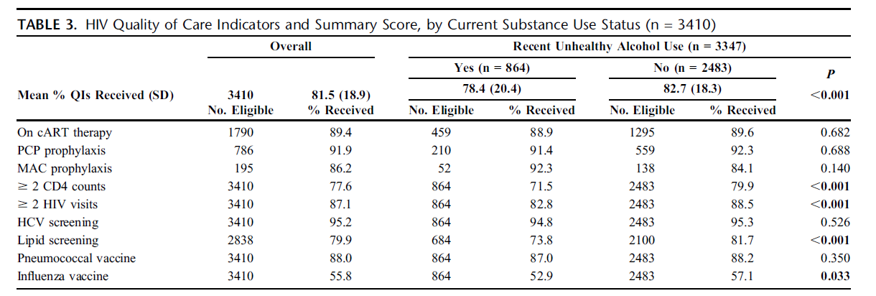
Alcohol and Quality of Care
Those with unhealthy alcohol use were less likely to have CD4 counts, HIV visits
or appropriate lipid screening in the past 12 months.
Korthuis PT et al., JAIDS, 2012
Notes:
For a variety of potential reasons, alcohol consumption translates into decreased quality of care.
These recently published data using a Veteran Sample, found that those with unhealthy alcohol use were less likely to have had CD4 counts and visits or appropriate lipid screening in the past 12 months.

Slide 9
Alcohol and Retention in Care
Monroe A et al JAIDS 2016

Slide 10
Alcohol and Mortality Risk by HIV status
Justice AC et al DAD 2016

Slide 11
Suboptimal Treatment of Alcohol Use in HIV Clinics
Unhealthy alcohol use is not consistently discussed with HIV providers
Few HIV providers report provision of evidence-based alcohol related care
Limited prior training of alcohol pharmacotherapy
In VA-based sample, among PLWH with unhealthy alcohol use and documented alcohol use disorder only 6% were prescribed alcohol pharmacotherapy
Metsch et al. DAD 2008; Chander et al. JAIDS 2016; Williams EC et al. DAD 2017

Slide 12
Alcohol Pharmacotherapy

Slide 13
Disulfiram
Property | Description
Mechanism | Blocks aldehyde dehydrogenase causing build-up acetaldehyde with alcohol consumption
Effect | Unpleasant feeling with alcohol consumption (flushing, headache, vomiting, dyspnea, confusion)
Dosing | Initial dose 250mg daily → 500 mg
Side Effects | Idiosyncratic fulminant hepatitis, neuropathy, psychosis and symptoms that resolve with stopping the medication (headache, drowsiness, fatigue, rash, pruritus, dermatitis, garlicky taste in mouth)
Cautions | Increased reaction in patients with CAD, receiving treatment for HTN, or with esophageal varices; need to understand effects of medication; avoid if rubber, cobalt or nickel allergy; pregnancy; ATV may interfere
Administration | Goal is abstinence; supervised dosing most effective
Clinical Effectiveness | Limited efficacy in clinical practice
Saitz R NEJM 2005; Franck J Current Opinion Neurobio 2013; McCance-Katz EF Am J Add 2014
Notes:
FDA approved in 1951
VA-based study in 1980s: 52 week trial with 605 alcohol dependent men demonstrated that 250mg of disulfiram had benefit over placebo in preventing relapse only in those patients who complied to treatment (20% of 577 who completed the study) but was ineffective in promoting continuous abstinence or in delaying the resumption of drinking – ref Franck)
Can also block dopamine beta hydroxylase to increase dopamine levels
Atazanavir may interefere with effectiveness of disfulfiram – no evidence of effect on ART effectiveness

Slide 14
Acamprosate
Property | Description
Mechanism | NMDA modulator to promote glutamate and GABA balance; decreases dopamine excitability
Effect | Decreasing craving
Dosing | 666mg three times daily
Side Effects | Diarrhea
Cautions | Contraindicated in renal insufficiency (creatinine clearance < 30 ml/min); half a dose in those with creatinine clearance >30-50 ml/min
Clinical Effectiveness | Variable data (negative results COMBINE and PREDICT); most effective with detoxification prior to treatment initiation and goal of promoting and maintaining abstinence
Saitz R NEJM 2005; Franck J Current Opinions in Neurobiol 2013;
Maisel NC Addiction 2013
Notes:
FDA approved in 2004
NMDA modulator to promote glutamate and GABA balance that is dysregulated with chronic alcohol consumption; decreases dopamine excitability in the nucleus accumbens during alcohol withdrawal and general neuronal hyperexcitability
To reduce withdrawal associated distress and modify learned responses to alcohol cues.
Literature is mixed – meta-analysis including 17 studies, including 4087 alcohol dependent individuals, continuous abstinence rates at 6 months were greater than for those who received placebo. Multi-site USA based trial and the large COMBINE trial, no evidence of effect of acamprosate over placebo.
Follow-up Cochrane meta-analysis – 24 RCTS found 11% increase with acamprosate on cumulative duration of abstinence, and 14% less risk in time to return to any drinking.
Efficacy relates to 1) compliance 2) motivation towards abstinence

Slide 15
Naltrexone
Property | Description
Mechanism | μ-opioid receptor antagonist
Effect | Decreases euphoria with alcohol Decreases alcohol craving Decreases heavy drinking days
Dosing | Oral: 50mg daily Injectable: 380mg
Side Effects | Nausea, headache, dizziness, nervousness, fatigue, insomnia, vomiting, anxiety, somnolence, dry mouth, dyspepsia, elevated LFTs, depression
Cautions | Contraindicated in patients with opioid use; relatively contraindicated in patients with hepatitis or cirrhosis
Suggested Monitoring | Symptoms and periodic LFTs
Administration | Appropriate for those not committed to abstinence and does not require abstinence prior to initiation
Saitz R NEJM 2005
Notes:
Capitalizes on alcohol’s effects on activation of mesolimbic dopamine release in the nucleus accumbens and blocking the dopaminergice effects of brain endorphins that are released following alcohol consumption; enhances alcohol’s sedating effects; reduce craving for alcohol – both when consumed and in the setting of cues
Moderate effect size
Variability in effect related to OPRM! – ASP40 (118G) allele
EFFECTS – decreases heavy drinking and prevent relapse among those who have achieved abstinence
Naltrexone blocks the reinforcing effects of alcohol – studies have shown that oral naltrexone is superior to placebo in preventing relapse to heavy drinking after an initial abstinence, in reducing craving and in increasing the percentage of abstinent days, increases time to relapse
Black box warning for risk of liver damage – less likely with injectable formulation as it does not undergo first pass hepatic metabolism
FDA approved 1994; injectable formulation
It decreases alcohol consumption in patients with heavy drinking – prevents relapse in patients who have achieved abstinenece; relapse prevention in patients with opioid dependence

Slide 16
Naltrexone Safety in HIV: LFTs
Tetrault JM et al. ACER 2011
Notes:
Of particular concern with naltrexone is the potential for hepatoxicity – with a black box warning for both oral and injectable formulations – esp in folks with underlying liver problems.
Due to concerns regarding hepatotoxicity with naltrexone, members from our group evaluated the effects of naltrexone using the Veterans Aging Cohort Study – VC
HIV-infected patients receiving their first prescription for oral naltrexone and with at least 7 days prescription –
In this sample of 114 patients, where 57% had HCV co-infection, median duration of use of 49 days
Mean ALT and AST levels decreased both during and post-naltrexone prescription; among patients with complete data at all three time points – mean levels decreased or remained stable during and post-naltrexone prescription – remained below the upper limit of normal.

Slide 17
Naltrexone Safety in HIV: HIV Biomarkers
Tetrault JM et al. ACER 2011
Notes:
Also to evaluate whether naltrexone impacted HIV disease progression, the authors assessed the relationship between naltrexone use and HIV biomarkers.
No change in adjusted mean CD4 count during and post-naltrexone prescription compared to pre-naltrexone prescription.
Adjusted mean HIV RNA decreased from 1597 copies pre-naltrexone to 695 copies post-naltrexone
Findings consistent in sensitivity analysis among patients with complete data.

Slide 18
Acamprosate vs. Naltrexone
Need to treat 12 people with acamprosate to prevent return to any drinking
Need to treat 20 people with oral naltrexone to prevent return to any drinking and 12 to prevent return to heavy drinking
No significant differences with acamprosate vs. naltrexone in direct comparisons
Jonas 2014 JAMA

Slide 19
Extended-Release Naltrexone in HIV Treatment Settings
Korthuis PT Addiction 2017

Slide 20
Your experiences?

Slide 21
Contact Information
Beth Porter, MBA (Project Coordinator)
elizabeth.porter@yale.edu
Srinivas Muvvala, MD (Co-Investigator)
srinivas.muvvala@yale.edu
E. Jennifer Edelman, MD, MHS (Project Director)
ejennifer.edelman@yale.edu
David Fiellin, MD (Principal Investigator)
david.fiellin@yale.edu
Kenneth Morford, MD (Postdoctoral Fellow)
Kenneth.Morford@yale.edu

