Slide 1
2019 Updates
WHAT-IF? Learning Collaborative
May 8, 2019

Slide 2
Outline
Poster Presentations
Interdisciplinary intervention for hospitalized persons who inject drugs (PWID) may increase medication assisted therapy (MAT) use
Oral Presentations
Opioid overdose deaths among persons with HIV infection, United States, 2011-2015
Hidden in Plain Sight: The Alcohol Epidemic
Smoking and unhealthy drinking and the HIV care continuum
Tobacco Smoking: The Silent Killer
HIV infection and smoking differentially regulate alveolar macrophages

Slide 3
Poster Presentations

Slide 4
Interdisciplinary intervention for hospitalized PWID may increase MAT use
Ellen F. Eaton, et al.
University of Alabama, Birmingham, AL, USA
UAB Hospital developed the Intravenous antibiotics and Addiction Team (IVAT) for PWID admitted with acute bacterial infections, which includes:
Addiction Medicine consult
Infectious Disease consult
9-item risk assessment of continued IVDU
Examined the effect of IVAT on prescriptions for methadone, buprenorphine, or naltrexone at discharge before and after IVAT implementation
Logistic regression was used to determine whether “high risk” patients were more likely to receive a prescription after IVAT implementation

Slide 5
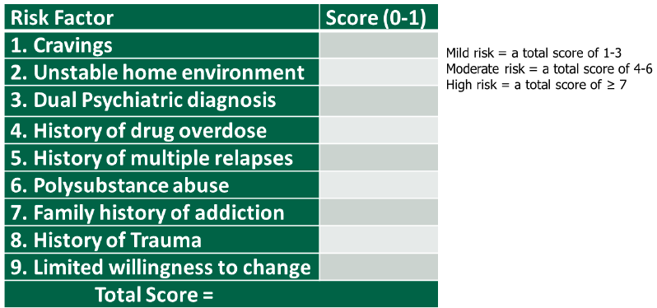
9-item Risk Assessment Tool

Slide 6
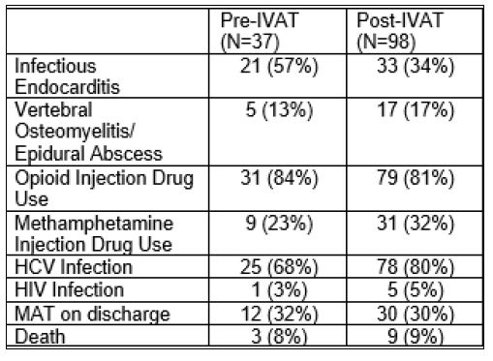
Results & Conclusions
MOUD prescriptions increased post-IVAT, but the percentage of prescriptions did not
No significant associations found between MOUD at discharge and 9-item risk category or sociodemographic characteristics
IVAT may serve as a platform for MOUD, HIV prevention (PrEP), STI testing, and harm reduction
Further interventions are needed particularly for increasing IV methamphetamine use, which does not respond to MOUD
Patient demographics before and after IVAT.
Notes:
A total of 37 and 98 patients met criteria in the pre and post-IVAT periods, respectively. 84% of pre-IVAT were opioid users compared to 80% post-IVAT. Most common bacterial infections in the pre and post-IVAT periods were endocarditis (57 and 34%, respectively) and vertebral osteomyelitis/ abscess (13 and 17%). In the pre- and post-IVAT periods, Hepatitis C was present in 68 and 80%, respectively, and HIV was present in 3 and 5%, respectively. Percentages with an ID consult (97% vs 94%) and Addiction Medicine (78% vs 84%) consult remained unchanged. Although MAT prescriptions increased, the percentage receiving MAT did not (32% pre and post IVAT). There was an increase for those deemed 'high risk' for continued IVDU (55%). In univariate logistic regression models of those receiving IVAT, neither risk category, age, race, gender, length of stay, or insurance status was associated with MAT prescription.

Slide 7
HIV infection & smoking differentially regulate alveolar macrophages
Charles P. Neff, Thomas Campbell, Andrew Fontenot, Brent E. Palmer
University of Colorado, Anschutz Medical Campus, Aurora, CO, USA
HIV impacts immune cells in the lung leading to pulmonary complications which persist with ART
Alveolar macrophages (AM) are principle immune cells in the bronchoalveolar compartment
Examining the effect of HIV on AM is complicated by the high prevalence of smoking in PLWH, which inhibits the reliability of traditional flow cytometry
This study examined the use of Cytometry by Time of Flight (CyTOF) to evaluate the effects of HIV and smoking on AM

Slide 8
Methods
Bronchoalveolar lavage cells were subjected to traditional flow cytometry and CyTOF from 4 groups:
10 untreated PLWH non-smokers
9 untreated PLWH smokers
10 HIV-negative non-smokers
9 HIV-negative smokers

Slide 9
Results & Conclusions
AM from PLWH demonstrated a loss of alternatively activated AMs leading to increased activation and inflammation
AM from smokers showed increased expression of CCR2 which is a marker of inflammatory macrophages
Findings indicate that HIV and smoking drive AM toward an inflammatory state via different mechanisms, leading to an overall more inflammatory environment in the lung

Slide 10
Smoking & unhealthy drinking and the HIV care continuum
Derek Satre, et al.
UCSF, Kaiser Permanente Northern California
Retrospective cohort study using electronic health record data to evaluate associations between smoking and unhealthy drinking with linkage to HIV care, retention, and HIV RNA control
Participants: N=9,397 PLWH in the Kaiser Permanente Northern California system between 7/2013-12/2017
Notes:
We examine associations between smoking and unhealthy drinking with linkage to care, retention and HIV RNA control among 9,397 people living with HIV (PWH) receiving care in the Kaiser Permanente Northern California (KPNC) integrated health care system, screened for unhealthy drinking (index date) and for smoking by providers between 07/01/2013 and 12/31/2017. Measures, derived from the electronic health record, included any self-reported unhealthy drinking in the prior 90 days (one or more days of 4+/5+ drinks per occasion and/or 7+/14+ drinks per week for women or men, respectively); smoking status closest to the drinking index date; linkage to care (≥1 visit within 90 days following a new HIV diagnosis); retention up to 12 months after alcohol screening (2 or more HIV care visits 60+ days apart); and HIV RNA control (<75 copies/mL) between 3 months prior and 12 months post alcohol screening. Unadjusted and adjusted odds ratios (OR) from logistic regression models (see Table for covariates in adjusted models).
*clarify definition of unhealthy alcohol use and how it reflects a spectrum of drinking patterns

Slide 11
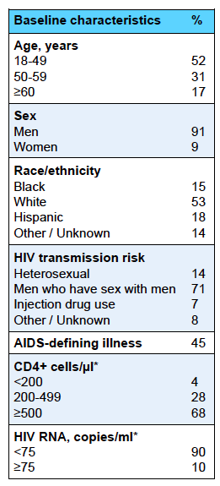
Mean age 47.1 years
Mostly male
Over 50% white
Mostly MSM
Majority with HIV RNA control
Notes:
The overall sample had mean age 47.1 years and was 91.2% male; 53.3% white, 18.0% Latino, and 15.3% black; and 70.5% men who have sex with men.

Slide 12
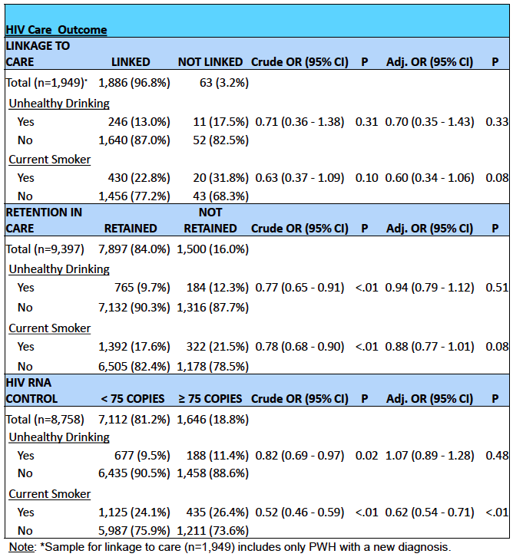
Notes:
In adjusted analyses, current smoking was associated with worse HIV RNA control (compared with not smoking at index date; OR=0.62 [95% CI 0.54-0.71], p<0.001), with some evidence of associations with worse retention (0.88 [0.77-1.01], p = 0.076) and worse linkage to care (0.6 [0.34-1.06], p=0.080). There was little evidence that unhealthy drinking at these thresholds was associated with linkage to care, retention in care or HIV RNA control.

Slide 13
Conclusions
Unhealthy drinking and smoking were associated with worse retention in care and HIV RNA control among PLWH
Only the effect of smoking on HIV RNA control remained in adjusted analyses
Clinicians should make a particular effort to help PLWH quit smoking
Notes:
Both unhealthy drinking and smoking were associated with worse retention in care and HIV RNA control among PWH, but only the effect of smoking on HIV RNA control remained in adjusted analyses. Future analyses will examine effects of higher levels of unhealthy drinking and changes in drinking, as well as unhealthy drinking in combination with smoking. Clinicians should make a particular effort to help PWH quit smoking.
*Substance use affecting outcomes on the HIV care continuum

Slide 14
Oral Presentations

Slide 15
Opioid overdose deaths among persons with HIV infection, United States, 2011-2015
Karin A. Bosh
Centers for Disease Control and Prevention, Atlanta, GA
Link to presentation

Slide 16
Tobacco Smoking: The Silent Killer
Lene Ryom
Centre of Excellence for Health, Immunity and Infections, Copenhagen, Denmark
Smoking rates are disproportionately high in PLWH
Smoking is the leading cause of preventable mortality among PLWH
PLWH are almost 20% less likely to quit smoking than the general population
Smoking cessation should become a top priority in the clinical management of PLWH

Slide 17
Notes:
The smoking rate among PLWH is 2-3x higher than the general population around the world. And the prevalence rates are similar for both men and women with HIV. The reasons for this are thought to be due to..

Slide 18
Notes:
Let’s look at the relevance of HIV status on smoking impact. Although there is no evidence supporting association between smoking and risk of HIV seroconversion, some evidence suggests…

Slide 19
Notes:
In the WIHS (“wise”) study, smoking women with HIV experienced more virologic rebound and reported lower ART adherence compared to non-smoking women with HIV.
Some questions this study raised is whether there is a causal relationship between smoking and HIV or whether smoking is a proxy for other factors impacting adherence and viral suppression, such as socioeconomic… Or whether it’s a combination of the both.

Slide 20
Notes:
These data from 2010 from the SMART study show that both current and former smokers had increased risk of all-cause mortality compared to non-smokers. Adjusted models showed that current smokers had a 2.4 increased risk of mortality compared to former smokers. These data have led to government agencies such as the CDC to state that smoking is the leading cause of preventable disease and death.

Slide 21
Notes:
In 2013, the Danish HIV Cohort showed that more than 12 life-years were lost from being a smoker living with HIV.

Slide 22
Notes:
Luckily smoking cessation has been shown to reduce the risk of excess morbidity and mortality.
Enhanced nicotine metabolism making it more difficult to quit smoking.

Slide 23
Notes:
The European AIDS Clinical Society provides recommendations on how to approach smoking among PLWH. A crucial first step is to assess smoking status. Then to provide advice about the consequences of smoking and benefits of quitting. If the patients is willing to quit, we should offer a combination of pharmacotherapy and cognitive-behavioral counseling. Pharmacotherapy helps to control withdrawal symptoms, including craving, insomnia, problems with concentration, irritability and weight gain.
Behavioral counseling comes in many forms and aims to…

Slide 24
Notes:
Current pharmacotherapy includes NRT, varenicline, and buproprion. The efficacy data for NRT among PLWH is “patchy” and typically reports low adherence rates among PLWH. As a result, most findings are generalized from studies with the general population.
Non-NRT meds include varenicline and bupropion. Varenicline has been shown to be more efficacious among PLWH compared to placebo. There’s been some concern about risk of depression and CVD, but a recent French trial did not find these associations.
There’s limited data on efficacy of bupropion among PLWH, so data are generalized from the general population.
Unfortunately, smoking cessation studies in PLWH are small with limited follow-up with a focus on behavioral approaches.

Slide 25
Notes:
We need to appreciate that the smoking epidemic in PLWH differs significantly than in the general population. Specifically…

Slide 26
Hidden in Plain Sight: The Alcohol Epidemic
Leikness C. Simbayi
Human Sciences Research Council, Pretoria, South Africa
Harmful alcohol use imposes a large social and economic burden
Causal relationships have been established between harmful alcohol use and risk of HIV acquisition
Policy and intervention programs have been proposed to address the convergence of these two epidemics

Slide 28
Notes:
Effects on cellular structure

Slide 32
Take Home Messages
Smoking and unhealthy alcohol use are disproportionately prevalent among PLWH, have negative impacts on HIV treatment outcomes, and should be prioritized by providers
Despite decreased total deaths among PLWH, opioid overdose deaths increased by 43% from 2011-2015
Novel interventions are being developed to treat opioid use disorder and prevent HIV transmission among PWID

Slide 33
Questions, Comments & Discussion

Slide 34
Additional Slides

