Slide 1
“Ending the HIV & HCV Epidemics: a critical Role for Substance Use Disorder Providers”

Slide 2
Ways you might use this slide deck
NAHEWD receives request [via ORN contacts] to present this information in your area
Incorporation into relevant non-NAHEWD/ORN events (i.e. upcoming AETC trainings, newsletters)
PRIMARY GOALS OF SLIDEDECK:
Encourage substance use disorder providers to think about HIV/HCV in their daily work
Generate additional requests to AETCs for further HIV education, support/TA
Connect substance use disorder providers with their regional AETC

Slide 3
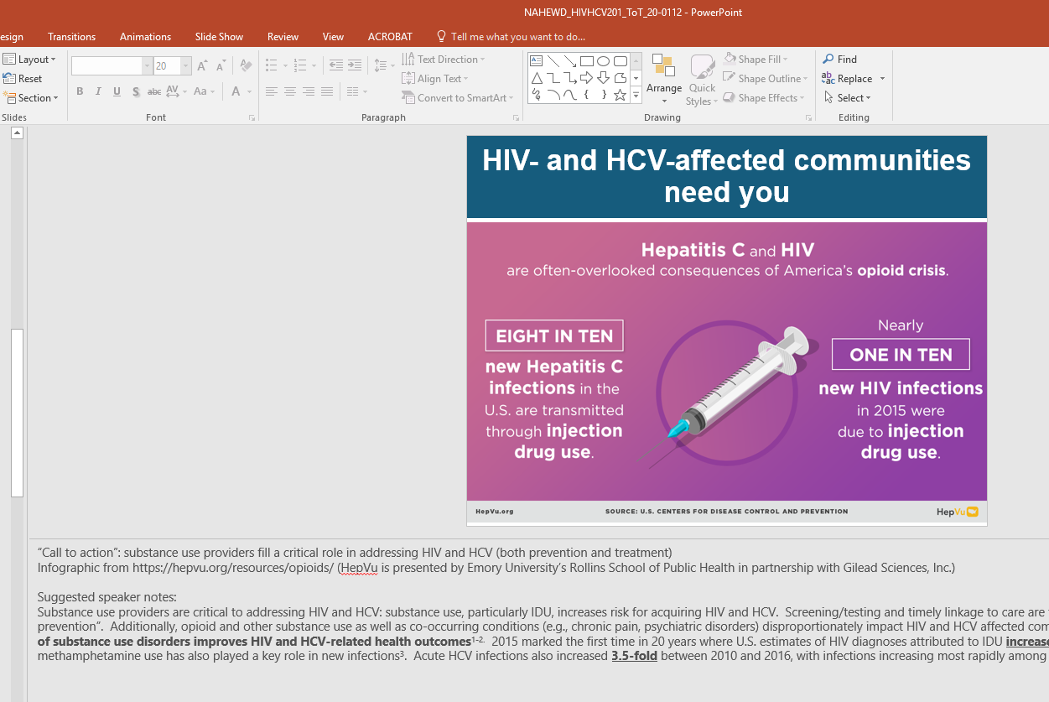
A few housekeeping items!
If you present these slides, please let your regional AETC office know, so that your presentation can be included in NAHEWD’s monthly report to ORN
Anticipated length: 15-20 min (feel free to modify content as much or as little as you’d like!)
Developed for mixed audiences
508 compliance
Speaker notes are included

Slide 4

Ending the HIV & HCV Epidemics:
A Critical Role for Substance Use Providers
Speaker(s)
Role/Organization
Date
Notes:
Insert speaker name(s), title/role/organization, date of presentation

Slide 5
Funding statement
Funding for this initiative was made possible (in part) by grant no. 6H79TI080816 from SAMHSA. The views expressed in written conference materials or publications and by speakers and moderators do not necessarily reflect the official policies of the Department of Health and Human Services; nor does mention of trade names, commercial practices, or organizations imply endorsement by the U.S. Government.
Notes:
Financial support text indicating SAMHSA funding (AAAP is primary recipient for STR-TA/ORN)

Slide 6
Learning objectives
Describe the overlap between the opioid, HIV, and hepatitis C (HCV) epidemics
Reflect on the unique role substance use providers can play in HIV and HCV screening and prevention, and “ending the epidemics”
Share information on resources and educational opportunities offered by HRSA’s national AIDS Education and Training Center (AETC) Program
Notes:
Learning objectives for this initial/short slide deck on HIV-HCV 101 for substance use providers

Slide 7
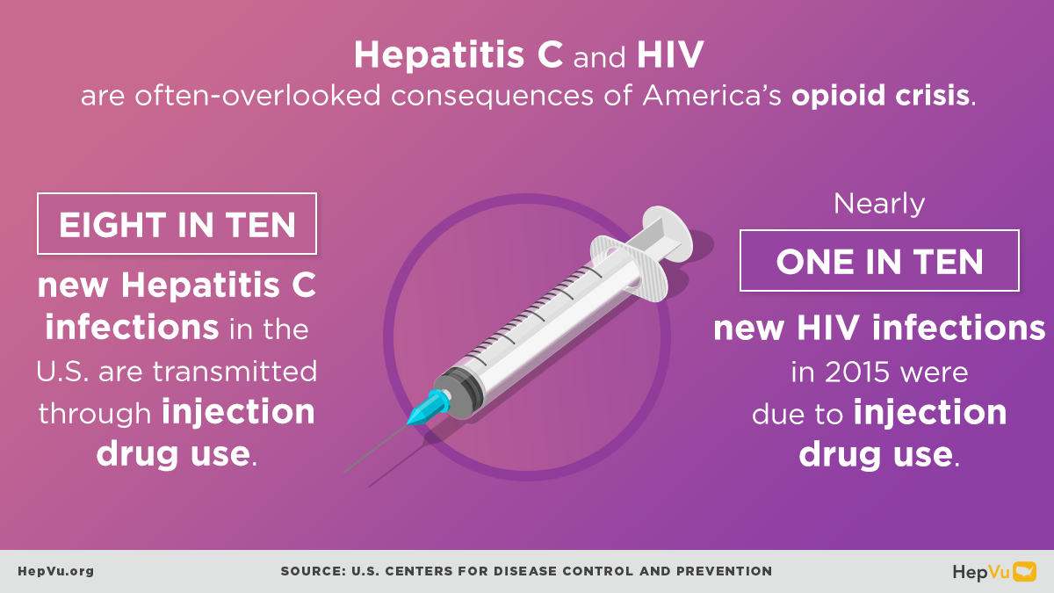
HIV- and HCV-affected communities need you
Notes:
“Call to action”: substance use providers fill a critical role in addressing HIV and HCV (both prevention and treatment)
Infographic from https://hepvu.org/resources/opioids/ (HepVu is presented by Emory University’s Rollins School of Public Health in partnership with Gilead Sciences, Inc.)
Suggested speaker notes:
Substance use providers are critical to addressing HIV and HCV: substance use, particularly IDU, increases risk for acquiring HIV and HCV. Screening/testing and timely linkage to care are the first steps in fully realizing HIV and HCV “treatment as prevention”. Additionally, opioid and other substance use as well as co-occurring conditions (e.g., chronic pain, psychiatric disorders) disproportionately impact HIV and HCV affected communities. There is strong evidence base that indicates treatment of substance use disorders improves HIV and HCV-related health outcomes^{1-2.} 2015 marked the first time in 20 years where U.S. estimates of HIV diagnoses attributed to IDU increased: this was largely associated with the opioid epidemic, although methamphetamine use has also played a key role in new infections³. Acute HCV infections also increased 3.5-fold between 2010 and 2016, with infections increasing most rapidly among young PWID⁴

Slide 8


What are our “Ending the Epidemic” goals?
Goals for HIV
Goals for HCV
Reduce new HIV infections in the United States by 75% in 5 years and by 90% by 2030⁵
Prevent new viral hepatitis infections
Reduce deaths and improve the health of people living with viral hepatitis
Reduce viral hepatitis health disparities
Coordinate, monitor, and report on implementation of viral hepatitis activities⁶
Notes:
Suggested speaker notes:
It’s important to be aware of our national goals for ending the HIV and HCV epidemics. In the February 2019 State of the Union Address, the current Administration announced its goal to end the U.S. HIV epidemic within 10 years. The primary goal is to reduce new HIV infections in the U.S. by 75 percent in five years, and by 90 percent by 2030. For more information on the federal plan, see https://www.hiv.gov/federal-response/ending-the-hiv-epidemic/overview. Regarding our viral hepatitis goals, the National Viral Hepatitis Action Plan 2017-2020 is our current national “guidebook” that includes a plan outlining the four major goals shown here. The Action Plan also includes strategies to achieve those goals and indicators to help track progress between now and 2020. For more information on the national viral hepatitis plan, see https://www.hhs.gov/hepatitis/viral-hepatitis-action-plan/index.html.
(The Viral Hepatitis Action Plan was developed collaboratively by more than 20 federal partners from the U.S. Departments of Health and Human Services, Housing and Urban Development, Justice, and Veterans Affairs with input from nonfederal stakeholders.

Slide 9
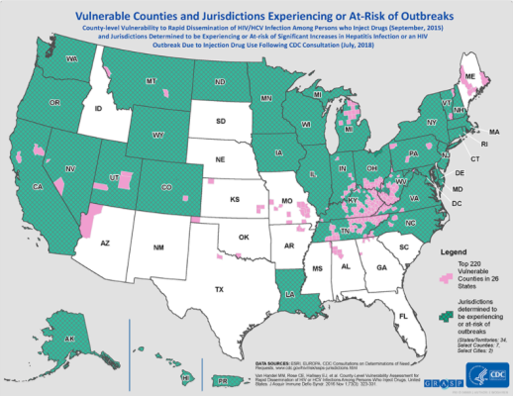
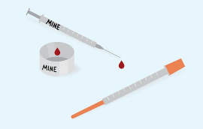

Has the CDC predicted an HIV/HCV outbreak in your community?
As of 2018, only 18 of 220 “vulnerable” counties had syringe exchange programs
Map: https://www.cdc.gov/pwid/vulnerable-counties-data.html
Other images from Harm Reduction Coalition
Notes:
Suggested speaker notes:
Some of you may have seen this map, which was released in 2016 (citation viewable via link). The map describes projected county-level vulnerability to rapid dissemination of HIV/HCV infections among persons who inject drugs a well as jurisdictions determined to be experiencing or at-risk of significant increases in hepatitis infection or an HIV outbreak due to IDU. CDC was involved with this analysis. [Map highlights the top 220 vulnerable counties in 26 states and jurisdictions determined to be experiencing or at-risk of outbreaks (States/Territories: 34, Select Counties: 7)]
Since Scott County, clusters of diagnoses have been described (primarily among networks of PWID) in: Seattle, Montana, Northern Massachusetts, and Florida. As recently as September of 2019, a new HCV outbreak was identified in Cabell County, West Virginia (https://www.politico.com/story/2019/09/02/hiv-opiods-cabell-west-virginia-1668389). It is important to note that as of early 2018, only 18 of the 220 “vulnerable” counties had syringe exchange programs in place, highlighting an area of critically unmet need.

Slide 10





Substance use care is not so different from HIV/HCV care: guiding principles
Harm reduction
Person-centered care, emphasis on positive changes
Other prevention, screening
Regular screening
Treatment and engagement
Public health benefits
Linkage to care
Early identification of barriers, facilitators
Focus on patient safety, well-being
Integrated case management, navigators
Patient-informed troubleshooting
“Low threshold” care, “rapid” treatment initiation
Regular contact with patients and care partners
Medications are a critical part of treatment for individuals
Biomedical preventive interventions (i.e. PrEP)
1
4
3
2
Notes:
Suggested speaker notes:
For those of you who might be thinking “I can’t be an HIV/HCV provider”, I’m hoping today’s short presentation can convince you otherwise. Substance use care and HIV/HCV care have fundamentally similar approaches and core principles that we have tried to depict here.
For all of these conditions, the thing of primary importance is to always ensure the patient is at the center of any decision-making. For many patients, even engaging in care with a clinical professional can be a stigmatizing experience. Ambivalence towards treatment can be quite common, and we recommend that providers always strive to emphasize positive changes and “meet the patient where they’re at”.
One important component of harm reduction is remaining focused on patient safety and well-being rather than prioritizing abstinence or absolute avoidance of certain behaviors.
In terms of treatment, although there are some differences in our specific approaches to HCV, HIV, and substance use disorders, the commonalities are probably more significant than any differences. Treatment of HCV is short-term and curative, compared to HIV treatment which is life-long and NOT currently curative, and treatment for substance use disorders is often over the long-term. Despite this, a core evidence-based tenet is that medications play a central role in improving health outcomes. Beyond the individual patient level, we know that treating HCV, HIV, and substance use leads to improved public health outcomes. For example, with HIV, we can now fully embrace “U=U”, or the fact that someone who is living with HIV and has an undetectable VL on ARVs does not transmit HIV to their sex partners.
Importantly, we should try to minimize barriers to accessing care, be prepared to start treatment as soon as we have identified one of these conditions, and have reliable ways to stay in contact with our patients and other members of the care team, for example pharmacies. On the “prevention side”, it’s important to note we have effective means of preventing HIV, HCV, and substance use disorders. Regular screening is arguably one of the most important elements of prevention, and if you take home nothing else today, please remember to regularly screen for HIV and HCV.
For HIV, additional biomedical prevention interventions have proven effective- hopefully by now you have heard of pre-exposure prophylaxis, which is a medication that can be taken to prevent acquisition of HIV. There is substantial evidence on the effectiveness of PrEP, and now we need to ensure that more patients/communities are aware of PrEP, and have access to it if they are interested. Finally, linkage to care is crucial: ways to help improve and maintain engagement in care include early discussions with patients about any barriers and facilitators they are experiencing (or anticipate experiencing). Case managers and navigators can also be incredibly helpful.

Slide 11
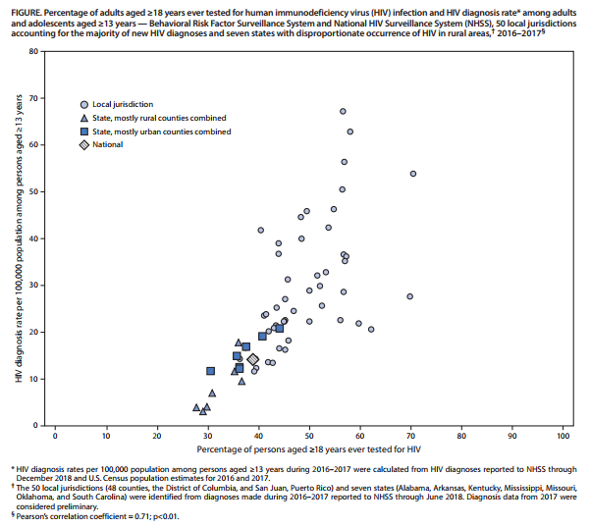
HIV screening: where are we at with this critical piece?
Among the 50 local jurisdictions that account for the majority of new HIV diagnoses in the U.S., 36.5% to 70.7% of persons aged ≥18 years ever tested for HIV; 8.1% to 31.3% tested in the past year. Among the 7 states with disproportionate rural HIV occurrence, testing percentages were generally low in both urban and rural areas.⁷
Notes:
Suggested speaker notes:
The next few slides focus on HIV-HCV screening, since that remains a central piece to ending these infectious disease epidemics. On this slide, there’s no need to focus too closely on the graph’s data points, axes, footnotes, etc. – the main point here is to demonstrate visually that a recently-published analysis determined that HIV screening rates remain quite variable, even in areas that account for a high number of new HIV diagnoses in the U.S. Among the 50 local jurisdictions that account for the majority of new HIV diagnoses in the U.S., as little as 36.5% and as many as 70.7% of adults (18yo+) have ever been tested for HIV. When looking at testing rates just over the past year, the range is even more striking: from only 8.1% to 31.3%. Among the 7 states with disproportionate rural HIV occurrence, testing percentages were generally low in both urban and rural areas. ⁷

Slide 12

Integrating HIV-HCV screening with substance use programs: room for improvement
HIV screening is not universal across substance use programs; further, only a small proportion offer on-site, HIV-specific services⁸
HCV testing rates also remain sub-optimal across opioid treatment programs in general: wide variation by program type; also, program leadership decision-making and varying translation of policies into practice seem to affect screening implementation¹¹
https://www.cdc.gov/stophivtogether/index.html
Notes:
Suggested speaker notes:
If you’re thinking at this point that your program is already doing a pretty good job at screening, that’s great! However, published evidence would actually suggest otherwise. HIV screening within substance use treatment programs remains highly variable in general. Less than 35-40% of privately-funded programs provide on-site HIV testing; and less than 15% offer additional on-site HIV medical care or “wrap around” HIV services such as support groups.⁹ Regarding HCV, screening practices across substance use programs also vary widely. Data suggest that on-site screening rates differ by OTP type, funding sources, and other factors including acceptability by management/staff. One interesting article hopefully noted that HIV testing legislative changes (i.e. removal of state pretesting counseling requirements) might have “spillover” effect on HCV testing practices.¹⁰ One might think that the lack of rules/regulations around HCV, as well as changes in HIV-related testing laws over time, could have widely facilitated increased rates of screening, but we haven’t really found that to be the case.

Slide 13
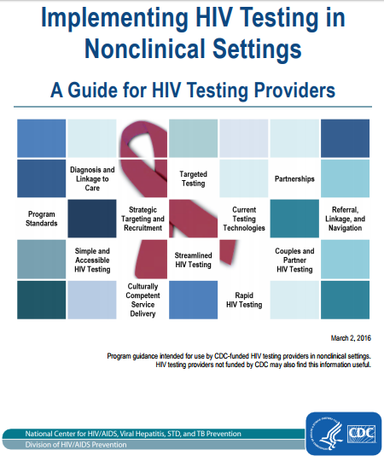
Opportunities to facilitate on-site screening
Routine, opt-out consent
Waiting/counseling/exam room signage
Standardized incorporation into intake and reassessment protocols
Point-of-care (“rapid”) assays
Reimbursement for testing services; new funding opportunities (e.g., federal EtE initiative, micro-elimination grants, substance use and HIV/HCV integration grants)
Share AETC “success stories”?
Highlight new/future funding
opportunities in your area?
Notes:
Suggested speaker notes:
As I mentioned previously, if there’s one key take home message we are trying to accomplish here, it’s the importance of HIV-HCV screening among substance-involved patients. There are many free, publicly-accessible resources available to help providers think through ways to increase HIV screening in varied care settings. A few “best practices” are mentioned here, namely opt-out consent processes, posting signs visibly throughout patient care areas, incorporating screening/testing into intake and reassessment procedures/protocols, and utilization of on-site/point-of-care screening assays.
Finally, we’d like to draw your attention to the fact that there are new opportunities available for treatment providers/programs to get involved with local “Ending the Epidemic” activities. Some of the new funding opportunities announced by various federal agencies including HRSA, CDC really emphasize developing collaborative, multi-sector partnerships. For example, local health departments linking with community health centers and patient service organizations, etc. Our program (i.e. NAHEWD and AETCs) would be happy to offer you/your organization tailored guidance and ideas to find and build relationships with HIV-HCV providers in your areas in order to meet pressing health needs of your shared patient communities.

Slide 14
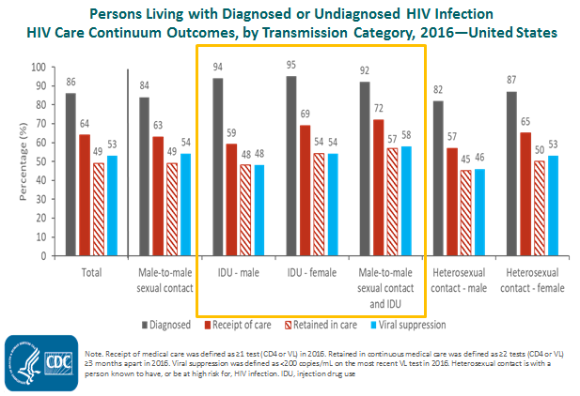
Beyond screening: needs are great across the HIV Care Cascade
Notes:
Suggested speaker notes (complete notes from CDC accompanying slides below):
This graph presents key outcomes along the HIV Care Cascade, compared by HIV risk factor. There’s quite a bit of data here and we would primarily like to draw attention to the finding that rates of linkage to care, engagement/retention in care, and viral suppression were relatively low among females with infection attributed to injection drug use (77.1%), as well as males with infection attributed to injection drug use (76.4%), and males with infection attributed to male-to-male sexual contact and injection drug use (75.3%). There are many inter-related factors that appear to drive these outcomes, including provider-level issues (for example, lower rates of ART initiation/provision among PWID have been noted as well as provider-based stigma) as well as other factors such as medication adherence challenges and housing instability. The key point here is that we have much room to improve on linking to care, keeping people in care, and supporting consistent access to medications to remain virally suppressed.
[Linkage was defined as having at least one CD4 or viral load test within 1 month of diagnosis. The estimates for linkage are based on data from 42 areas with complete reporting of CD4 and viral load test results to CDC as of December 2018.]
**Complete CDC notes: This slide presents the prevalence-based HIV care continuum for 2016 for persons living with diagnosed or undiagnosed HIV infection in the United States by transmission category. Among males living with HIV attributed to male-to-male sexual contact, 84% have received a diagnosis, 63% received HIV medical care in 2016, 49% were receiving continuous care, and 54% were virally suppressed. Among males living with HIV attributed to injection drug use, 94% have received a diagnosis, 59% received HIV medical care in 2016, 48% were receiving continuous care, and 48% were virally suppressed. Among females living with HIV attributed to injection drug use, 95% have received a diagnosis, 69% received HIV medical care in 2016, 54% were receiving continuous care, and 54% were virally suppressed. Among males living with HIV attributed to male-to-male sexual contact and injection drug use, 92% have received a diagnosis, 72% received HIV medical care in 2016, 57% were receiving continuous care, and 58% were virally suppressed. Among males living with HIV attributed to heterosexual sexual contact, 82% have received a diagnosis, 57% received HIV medical care in 2016, 45% were receiving continuous care, and 46% were virally suppressed. Among females living with HIV attributed to heterosexual sexual contact, 87% have received a diagnosis, 65% received HIV medical care in 2016, 50% were receiving continuous care, and 53% were virally suppressed.
Receipt of medical care was defined as ≥1 test (CD4 or VL) in 2016. Retained in continuous medical care was defined as ≥2 tests (CD4 or VL) ≥3 months apart in 2016. Viral suppression was defined as <200 copies/mL on the most recent VL test in 2016. Heterosexual contact is with a person known to have, or be at high risk for, HIV infection. IDU, injection drug use.**

Slide 15
Viral suppression among persons aged ≥ 13 years living with diagnosed HIV infection (2016): 41 states and District of Columbia
Note. Viral suppression was defined as <200 copies/mL on the most recent VL test in 2016. Residence was based on most recent known address as of year-end 2016.
Notes:
Suggested speaker notes:
This is another graph developed and released by the CDC, which indicates geographic variation in the percentages of persons virally suppressed during 2016 by jurisdiction. We thought it might be interesting to share here, if you’re curious to see how your state compares to others. The 10 states (Colorado, Illinois, Maryland, Mississippi, Ohio, Oregon, South Dakota, Tennessee, Utah, Virginia) and the District of Columbia (D.C.) in the darkest shade had the lowest percentages (≤56.4) of persons virally suppressed. The 10 states (Alaska, Iowa, Maine, Michigan, Montana, New Mexico, North Dakota, Rhode Island, Washington, and Wisconsin) in the lightest shade had the highest percentages (≥68.5) of persons virally suppressed.
[Viral suppression was defined as <200 copies/mL on the most recent VL test in 2016. Residence was based on most recent known address as of year-end 2016.]

Slide 16
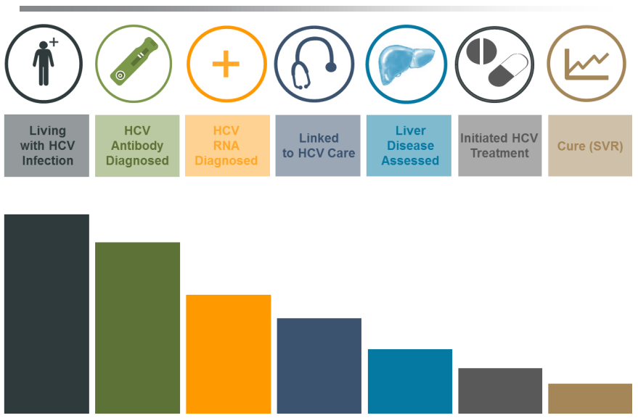
HCV Care Cascade among people who inject drugs
Vancouver¹²: 86.5% linked to care, 10.4% started HCV treatment, 4.5% completed treatment
San Francisco¹³: 60% referred, 17% started treatment, all cured
Infographic used with permission, J. Grebely
Notes:
Suggested speaker notes:
Most of the preceding slides have highlighted outcomes along the HIV Care Cascade: this slide is just a quick acknowledgement that we are starting to look much more closely at HCV Care Cascade outcomes, especially as we strive to improve access to HCV care and treatment throughout the U.S. Although we don’t have the same data and reporting systems in place for HCV at this time (compared to HIV), various studies have been published describing outcomes among specific cohorts of PWID/people with substance use disorders. Essentially all of them find HCV-specific health disparities affecting substance-involved populations.

Slide 17

IF YOU’RE PROVIDING SUBSTANCE USE CARE, YOU ARE WELL-POSITIONED TO PROVIDE HIV AND HCV CARE!
…already providing harm reduction?
CONSIDER ON-SITE HIV AND HCV SCREENING (AT INTAKE AND REGULARLY THEREAFTER)
…already screening for HIV and HCV?
OFFER PrEP FOR HIV PREVENTION!
…already providing “warm hand-off” to local HIV and HCV providers?
CONSIDER PROVIDING HIV AND HCV TREATMENT ON-SITE (INITIATION AND ONGOING MONITORING)
Notes:
Suggested speaker notes:
As we wrap up, I’ll leave people with some friendly challenges to chew on, in the hopes that we have at least piqued your interest at becoming a champion for HIV and hepatitis C. I really cannot overstate the following: if you’re already providing substance use care, you are incredibly well-positioned to help us end the HIV and HCV epidemics. For those of you who are already deep into the harm reduction space, consider implementing on-site HIV AND HCV screening at regular intervals for your clients. If you’re already universally screening for both HIV and HCV, consider offering PrEP as an additional intervention to prevent HIV. If you’re already screening and offering PrEP, consider integrating on-site HIV and HCV treatment into your program, rather than referring to a separate provider. Much evidence shows that integrated, co-located HIV/HCV care can vastly improve engagement in care and increase treatment success rates.
Also, there is one final point to mention in closing. Much of this particular presentation has been focused on integrating HIV-HCV care into substance use settings. It’s important to acknowledge that integration does not go in only one direction. Substance use care also needs to be integrated into HIV-HCV programs, and there are MANY ways to address areas of unmet need with regard to the provision of substance use care within HIV-HCV care settings. This includes increasing screening for substance use, counseling on risk/harm reduction, increasing clinician motivation and capacity to offer and manage medications for SUD treatment, and strengthening linkages between HIV-HCV and local substance use programs. If this is something that inspires and motivates you, please reach out to me/us after this presentation, and our organizations (NAHEWD/AETC) would be happy to work with you to bring your experience and passion to HIV-HCV care providers.

Slide 18
Select resources
“Effectiveness of Prevention Strategies to Reduce the Risk of Acquiring or Transmitting HIV” (CDC): https://www.cdc.gov/hiv/risk/estimates/preventionstrategies.html?deliveryName=USCDC_1046-DM64284
“Hepatitis C Questions and Answers for Health Professionals” (CDC): https://www.cdc.gov/hepatitis/hcv/hcvfaq.htm
Opioid Response Network (ORN): https://opioidresponsenetwork.org/
National HIV Curriculum, Hepatitis C Online: https://www.hiv.uw.edu/, https://www.hepatitisc.uw.edu/
National AETC Program
  Regional Training Centers provide local training, capacity building and technical assistance: https://aidsetc.org/directory
  National Clinician Consultation Center manages free clinical hotlines and warmlines including the HIV Warmline/Perinatal HIV Hotline, HCV Warmline, PrEPline, Substance Use Warmline, and PEPline: nccc.ucsf.edu
  National Coordinating Resource Center offers free, printed provider resources: https://aidsetc.org/community/order
Notes:
Suggested speaker notes:
Here are some select resources on the topic we covered today.
As some of you may already know, ORN provides local, experienced consultants to help you address prevention, treatment, and recovery for persons with opioid use disorders. ORN accepts requests for education and training. Examples of TA requests include: Substance Use Prevention; Medications for Addiction Treatment (MAT) Waiver Training; In-person and/or webinar trainings (topics have included Treating OUD, HIV and OUD); Assistance with creating a strategic plan; and Assistance with creating peer support programs. To submit a request to ORN, visit https://opioidresponsenetwork.org and click on the “Submit a Request” button at the top right.

Slide 19
References
Schwetz, T., et al. Opioids and Infectious Diseases: a Converging Public Health Crisis. Journal of Infectious Diseases, https://academic.oup.com/jid/article/220/3/346/5426470
Cunningham, C.O. Opioids and HIV Infection: From Pain Management to Addiction Treatment. Topics in Antiviral Medicine. https://www.ncbi.nlm.nih.gov/pmc/articles/PMC5935219/
Dawson. L. and Kates. J. HIV and the Opioid Epidemic: 5 Key Points. https://www.kff.org/hivaids/issue-brief/hiv-and-the-opioid-epidemic-5-key-points/
Substance Abuse and Mental Health Services Administration. https://www.samhsa.gov/sites/default/files/hivhepadvisory_letter-signed.pdf
What is ‘Ending the HIV Epidemic: A Plan for America’? https://www.hiv.gov/federal-response/ending-the-hiv-epidemic/overview
Action Plan Overview. https://www.hhs.gov/hepatitis/action-plan/national-viral-hepatitis-action-plan-overview/index.html
Pitasi, et al. HIV Testing in 50 Local Jurisdictions Accounting for the Majority of New HIV Diagnoses and 7 States with Disproportionate Occurrence of HIV in Rural Areas, 2016-2017. Morbidity and Mortality Weekly Report. 2019 Jun 28; 68(25): 561-567.
Cohn, A., et al. Characteristics of U.S. Substance Abuse Treatment Facilities Offering HIV Services: Results From a National Survey. Psychiatric Services. https://www.ncbi.nlm.nih.gov/pubmed/26975517
Aletraris, L. and Roman, P.M. Provision of Onsite HIV Services in Substance Use Disorder Treatment Programs: A Longitudinal Analysis. Journal of Substance Abuse Treatment. https://www.ncbi.nlm.nih.gov/pubmed/25934459
Frimpong, J., et al. Spillover Effects of HIV Testing Policies: Changes in HIV Testing Guidelines and HCV Testing Practices in Drug Treatment Programs in the United States. BMC Public Health. https://www.ncbi.nlm.nih.gov/pubmed/27473519
Frimpong, J. and D’Aunno. Hepatitis C Testing in Substance Use Disorder Treatment: The Role of Program Managers in Adoption of Testing Services. Substance Abuse Treatment, Prevention, and Policy. https://www.ncbi.nlm.nih.gov/pubmed/27036115
Young, S., et al. Hepatitis C Cascade of Care Among People Who Inject Drugs in Vancouver, Canada. Substance Abuse 2018; 39(4): 461 468. DOI: 10.1080/08897077.2018.1485128
Morris, et al. Treatment Cascade for Hepatitis C Virus in Young Adult People Who Inject Drugs in San Francisco: Low Number Treated. Drug and Alcohol Dependence 2019; 198: 133-135. DOI: 10.1016/j.drugalcdep.2019.02.008

Slide 20
Please contact us!
For more information, or to collaborate with NAHEWD, you can:
    Visit the NAHEWD website: www.nahewd.org
    E-mail Elizabeth Lazo: elazo@nahewd.org
Optional: Insert regional/local AETC contact information

