Slide 1
Office Based Treatment of Opioid Addiction: Buprenorphine in the Brownstone HIV Clinic
June 2019
Robin Deutsch, MD
Assistant Director of Infectious Disease
Associate Director of HIV
Director of Ambulatory Addiction Services
Hartford Hospital

Slide 2
Why?
Medical literature and best practices advocate integration of addiction treatment into primary care and HIV care
Evidence supports improved outcomes with integration into care
Patient demand and local need
Why not??

Slide 3
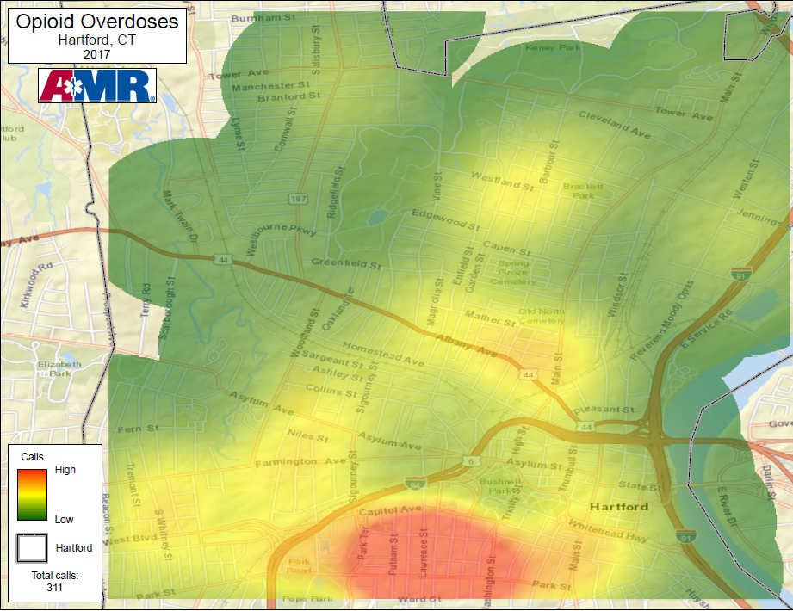
Source: Peter Canning, EMS Coordinator, UCHC
In summer 2017, 90% of bags of “heroin” in Hartford tested positive for fentanyl
During the first 4 months of 2018, 3,090 visits for suspected drug overdoses were made to the EDs at Connecticut’s 27 acute care hospitals
Notes:
HH has disproportionate share in geographic area
Only AMR EMS calls reported which covers north of Park St; Aetna covers south of Park St- not yet reporting

Slide 4
Buprenorphine in the Brownstone
Started in January 2016 in the Brownstone Community Care Center
One buprenorphine-waivered MD
Initially 1 session per week, currently 2-3 sessions per week
No budget
Tiered roll-out:
Initially limited to HIV primary care patients
-Patients wanting induction
-Patients wanting to transfer from Suboxone provider at alternate location to PCP (typically due to transportation, location, provider relationship)
-Patients referred from other CCC providers
Referrals of non-HIV patients from Adult Primary Care Clinic
Hospital-wide referrals including cardiology/cardiothoracic surgery
>45 patients evaluated and >581 patient visits since 2016 (updated Feb 2019)
Weekly rotation site for Rushford Addiction Medicine Fellows

Slide 5
Demographics
Urban residence
Medicaid
Older population (40s-50s)
Male > female
Onset of OUD with recreational heroin rather than prescribed opioids
Rare chronic pain
Occasional SNF resident
Co-occurring mental health disorders

Slide 6
Workflow
Referral via verbal communication or EPIC
Referral reviewed for appropriateness
Initial consultation scheduled to determine if good candidate
If not a good candidate or long wait time, referred elsewhere

Slide 7
Candidate Evaluation
Who I accept, how I get referrals
Education of referring providers
Inclusion/exclusion criteria
Diagnosis of OUD
Chronic pain patients
Serious about recovery
Bup vs methadone
Assess barriers: transportation, geographic
English or Spanish fluency

Slide 8
Initial Visit
Intake: history, review labs, medications
Treatment agreement
Urine drug testing (or oral)
Development of behavioral health treatment plan (shared negotiation)
Sign in sheet, meeting locations, BH referral
Counsel on induction
Follow up visit scheduled
Harm reduction, naloxone prescription
Verify pharmacy, Suboxone prescription sent electronically
Copy of signed agreement given
Check CTPMP

Slide 9
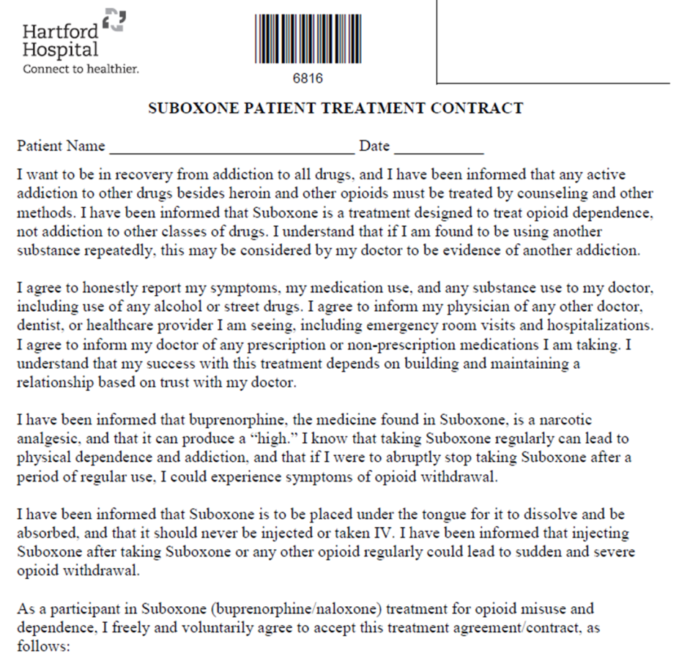
Treatment Agreement
Trust and honesty essential to success
For safety
“You’ll get out of it what you put into it”
Relapsing disease, testing is not punitive, emphasize work on patient’s part, recommendations if pattern of positive testing, review occurrences of use for skill-building opportunities
Not a “contract”

Slide 10
Drug Testing
Done at every visit
Oral- inaccurate, not reliable for nBup, ?false positive cocaine
Urine- not supervised; workflow- check in, get cup at beginning of visit
Consistently testing for Bup, cocaine, opiates; initial is more broad; occasionally fentanyl for education of patient
Hospital lab; DrugScan
Difficulty getting confirmatory testing, BZDs
Emphasize want to know prior from patient, no surprises
Recurrent cocaine
Timing for positivity, toxicology, false positives
Marijuana
Explore reasons for non-disclosure: commonly shame and guilt
Increase frequency of visits
Testing under EPIC favorites
POC tests available
Big picture: harm reduction: decreased use vs abstinence

Slide 11
Induction and Dosing
Home induction vs in-office
Variability of initial dosing based on amount of use
Assess timing of last use
Counsel on moderate opioid withdrawal, anticipatory withdrawal, risk of precipitated withdrawal
If morning/mid-afternoon: start with 4mg, take another 4mg 30-60 minutes later if no reaction, take 8mg in evening; no more than 16mg daily if heavy, 8mg if lighter use
Take total of day #1 on morning of day #2
Take extra 4-8mg as needed
Daily vs divided dosing
Most people titrate well to symptoms, often ignore instructions
Make quantity last
Short-interval follow up (<1 week if new, 1 week if experienced user)
Prescription until next appt plus a couple extra
Formulation: Suboxone (tab vs film), Subutex, Zubsolv, Bunavail, Butrans, Belbuca, depo injection
Average dose: 16mg; common 8mg TID

Slide 12
Follow Up
Stabilization, maintenance phase
Assess use of Suboxone
Assess drug use
Assess BH cooperation
Ask about adverse effects (constipation)
Treat insomnia
Modify dose as indicated
Frequency of appt decreases with progress: clinical status, reported use, UDS, BH follow through, dosing as prescribed
Initially once weekly
Weekly or every 2 weeks if cocaine
Minimum every 4 weeks (maintenance)

Slide 13
Behavioral Health
Emphasize importance of needing support, skill-building, coping with feelings/trauma, identifying reason(s) for ongoing use
Individualized plan, consider patient preference, location, prior history
Groups (IOP, relapse prevention weekly)
12-step meetings
Therapist or psychiatrist
Sign in sheet or documentation, ROI
During visit counseling
Skills/Coping strategies
Dealing with stress, boredom
Inability to refuse or dispose of drugs
Need to change social circle, habits, places, activities
“people, places and things”

Slide 14
Cancellations/Absences
Weather, illness, work
Flexibility to avoid gaps
Emphasize no guarantees of appointment availability and no covering provider
Form for insurance to cover lost/stolen prescriptions if a rare situation warrants
If no show, let patient initiate contact so patient-driven process, vs a wellness check

Slide 15
Philosophy
“Meet them where they’re at”
“Any positive change”
Low barrier, low threshold
May not be the best fit for all

Slide 16
Other Considerations
Nursing home form for pharmacy
E-prescribing, quantity
Bill based on time
Templates
Favorite orders
Documentation
Check PMP
Prior auth- private insurance, Medicaid often with dose change
Pain

Slide 17
Advantages:
Integrated care model
Patients appreciate one location
Improves communication among providers
Limitations:
Variability with scheduling, availability due to one provider with inpatient service obligation
Occasional wait times
Lack of behavioral health services on site (groups)

Slide 18
Patient Stories
September 2018:
58M with ESRD on dialysis, wheelchair-bound due to left BKA, Spanish-speaking only, daily heroin use
Referred by dialysis social worker: unable to get into other addiction treatment sites due to dialysis schedule, inability to produce urine for drug testing, and language barrier
Depressed mood and affect, insomnia
Reports abstinence from heroin since Suboxone initiation; all oral drug testing negative for opiates
Attending all appointments despite transportation issues
Established with behavioral health services for individual and group therapy
Improved mood/affect/sleep/appetite
October 2018:
53M with CHF EF 25%, NSTEMI, newly-diagnosed HIV, HCV, homelessness
Inpatient induction done with transition to Brownstone CCC for primary care, HIV care, Suboxone
Adherent to medications, improved sleep/energy/appetite; biking 4 hours
Notes:
Immense gratitude and appreciation from patients
If I can do this, imagine what can be done for patients who are ambulatory and English-speaking??

Slide 19
2017 CCC Suboxone Patient Survey Responses
Describe how the Suboxone Program has affected your life:
The Suboxone has helped me stop getting high and staying clean helped me 100 percent.
The Suboxone program has been my life saver NOT THE CANDY! But I mean literally it is saving my life EVERYDAY. The burden of lifelong addiction truly heavy to bare Suboxone has made that change.
The program has really and truly helped change my life the whole team of nurses and doctors are very well on board of helping us addicts get our lives back on the real life track it’s the best Suboxone program I’ve been on, that their really out to see us thru getting better. I thank them all for putting out so much positive feedback also giving me the chance to get my life together.
It has helped me a great deal really changed my life for the better.
It has helped me a great deal with my addiction. Thanks to the Staff
Has turned my life around and made me feel worthy again.
The use of those pills are doing great in my experience is one of the best things that happened in my life starting this program.
It better my life so I don’t have to keep doing drugs it’s been a load off my back. . .
Helps if your willing to live clean, Helps with pain.
It helps me improve.
Suggestions for improvement:
This is the best program that you did in the Brownstone CCC. I wish other people can join us 100%.
Its hard to come up with a way to make something that’s good better. I think all that’s needed is for someone that’s on the program is to remain honest with themselves and the people there to help them through what is better in life.
I like it as it is.
I would definitely refer the program to others. Group meetings would be great !
Right now for me everything is ok !
I think having a support group at least once a week.
Good enough.
They should have a nurse provider for the program.
I myself haven’t had any negative meetings at the Suboxone program, Group meetings would be nice – Thanks all
Notes:
Immense gratitude and appreciation from patients
Very rewarding

Slide 20
Termination
Negative urine drug testing
Attendance, inconsistency
Lack of BH follow through
Ongoing drug use
Violation of agreement
Offer alternatives to any patient being terminated
Emphasize that HIV primary care (or cardiology care, etc) remains unchanged

Slide 21
Resources
No budget
Personnel: front staff for check in, discharge
MA for vitals, rooming, urine specimen
RN visit if away
Maintain a list of patients

Slide 22
Questions?

